Slide 1

Managing Public Issues and Stakeholder Relationships
Chapter 2
Copyright ©2020 McGraw-Hill Education. All rights reserved. Authorized only for instructor use in the classroom. No reproduction or further distribution permitted without the prior written consent of McGraw-Hill Education.

Slide 2

Public Issues
Public Issue: Any issue that is of mutual concern to an organization and one or more of its stakeholders.
Stakeholder Expectations: A mixture of people’s opinions, attitudes, and beliefs about what constitutes reasonable business behavior.

Slide 3

Public Issues:
Performance-Expectations Gap
Failure to understand stakeholder concerns and to respond appropriately will:
  Permit the performance–expectations gap to grow.
  The larger the gap, the greater the risk of stakeholder backlash or of missing business opportunity.
Example:
Antibiotics in chicken.

Slide 4
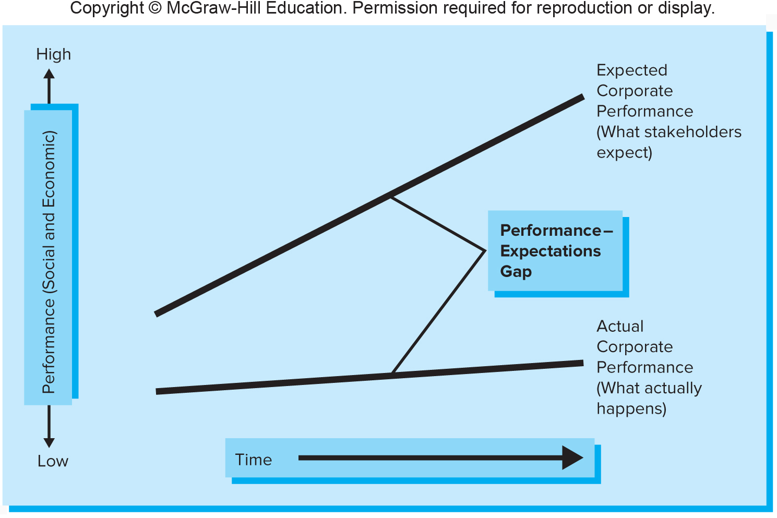
The Performance-Expectations Gap
Figure 2.1
Copyright © McGraw-Hill Education. Permission required for reproduction or display.
Access the text alternative for these images.

Slide 5
Environmental Analysis and Intelligence
Environmental Analysis: A method managers use to gather information about external issues and trends
Environmental Intelligence: the acquisition of information gained from analyzing the multiple environments affecting organizations.
Notes:
Environmental Analysis: A method managers use to gather information about external issues and trends
to develop an organizational strategy that minimizes threats and takes advantage of new opportunities.
Environmental Intelligence
The systematic and continuous process of gathering, analyzing, and managing external information about the organization’s competitors that can affect the organization’s plans, decisions, and operations. With the need to comply with all applicable laws, and to follow the professional standards of fairness and honesty.

Slide 6
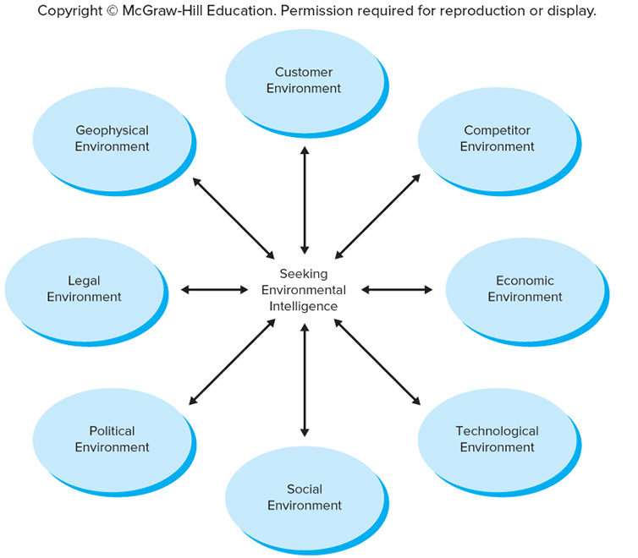
Eight Strategic Radar Screens
Figure 2.2
Copyright © McGraw-Hill Education. Permission required for reproduction or display.
Access the text alternative for these images.

Slide 7
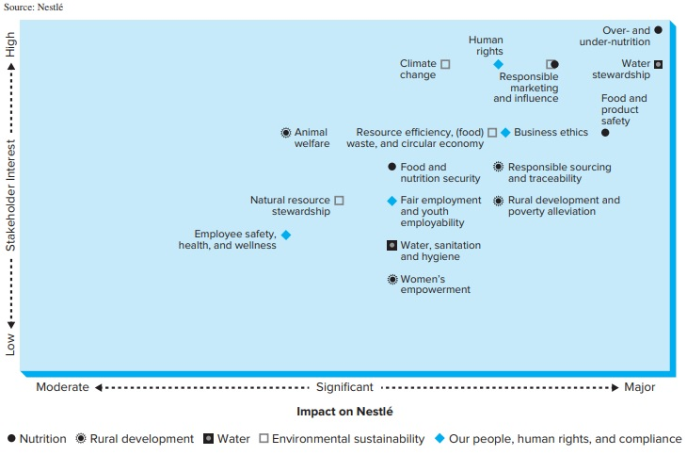
Stakeholder Materiality*
Copyright © McGraw-Hill Education. Permission required for reproduction or display.
Figure 2.3
*Adaptation of an accounting term to prioritize the relevance of the stakeholders and their issues to the company.
Access the text alternative for these images.

Slide 8
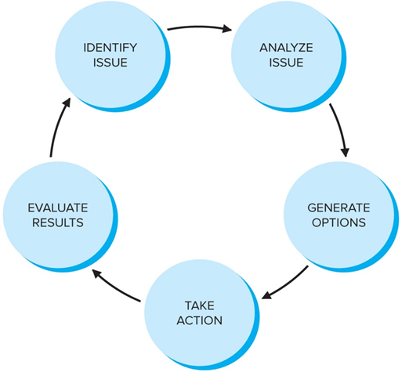
The Issue Management Process2
Figure 2.4
Copyright © McGraw-Hill Education. Permission required for reproduction or display.
Access the text alternative for these images.
Notes:
Identify Issue
Anticipating emerging concerns, or “horizon” issues.
Analyze Issue
Organizations must understand how the issue is likely to evolve, and how it is likely to affect them.
Generate Options
Requires complex judgments that incorporate ethical considerations like the company’s reputation.
Take Action
Once an option is chosen, the organization must design and implement a plan of action.
Evaluate Results
Must assess results of the program and make adjustments if necessary.

Slide 9

Organizing for Effective Issue Management
Part of the organization is mobilized to address a particular emerging issue, it often depends on the nature of the issue itself.
Effective global leadership on public issues requires three basic capabilities:
Notes:
Part of the organization is mobilized to address a particular emerging issue, it often depends on the nature of the issue itself.
Involve the board of directors and top management levels.
Effective global leadership on public issues requires three basic capabilities:
Understanding of the changing business context.
Ability to lead in the face of complexity.
Connectedness: the ability to engage with external stakeholders in dialogue and partnership.

Slide 10

Stages in the Business-Stakeholder Relationship
  Inactive
  Reactive
  Proactive
  Interactive
Notes:
Over time, the nature of business’s relationship with its stakeholders often evolve through a series of stages.
Inactive – Companies ignore stakeholder concerns.
Reactive – Companies act only when forced to do so, and then in a defensive manner.
Proactive – Companies try to anticipate stakeholder concerns.
Interactive –Companies actively engage stakeholders in an ongoing relationship of mutual respect, openness, and trust.

Slide 11

Drivers of Stakeholder Engagement1
Stakeholder engagement is, at its core, a relationship.
The Role of Social Media in
Stakeholder Engagement
Notes:
Stakeholder engagement is, at its core, a relationship.
The participation of a business organization and at least one stakeholder organization is necessary.
Engagement: both the company and its stakeholders have:
An urgent and important goal.
The motivation to participate.
The organizational capacity to engage with one another.
The role of Social Media in Stakeholder Engagement:
Address public issues and engage stakeholders.
Identify and solve problems faster.
Share information better among their employees and partners.
Bring customers’ ideas for new product designs to market earlier.
Platforms to engage with multiple stakeholders, communication has become faster and more effective.

Slide 12
Drivers of Stakeholder Engagement2
From Figure 2.5
Copyright © McGraw-Hill Education. Permission required for reproduction or display.
 | Company | Stakeholder(s)
Goal | To improve corporate reputation; to earn a license to operate; to win approval of society. | To change corporate behavior on an issue of concern.
Motivation | Needs stakeholder involvement because of their expertise or control of critical resources. | Governmental campaigns, protest perceived as inadequate to change corporate behavior.
Organizational capacity | Top leaders committed to engagement; well-funded department of external (stakeholder) affairs. | Experienced staff; core group of activists committed to dialogue with business.

Slide 13

Stakeholder Dialogue
Core interest and concerns, common definition of a problem.
Understandings and concerns of all parties.
Business and its Stakeholders come to face-to-face conversations.
Invent innovative solutions and implement them.
Example: Merck.
Notes:
http://files.visir-network.eu/wp-content/uploads/2012/06/consult.jpg

Slide 14

Stakeholder Networks
Addressing public issues by:
  working collaboratively with other businesses, concerned persons and organizations in stakeholder networks.
Stakeholder organizations bring a number of distinct strengths:
Example: Nike.
Notes:
Stakeholder organizations bring a number of distinct strengths:
Alert companies to emerging issues.
Give a firm access to information via networking.
Technical or scientific expertise in specific areas.
Better result in the eyes of the public.
Meet the society’s expectations and generate good solutions.
Improve a company’s reputation.

